Slide 1
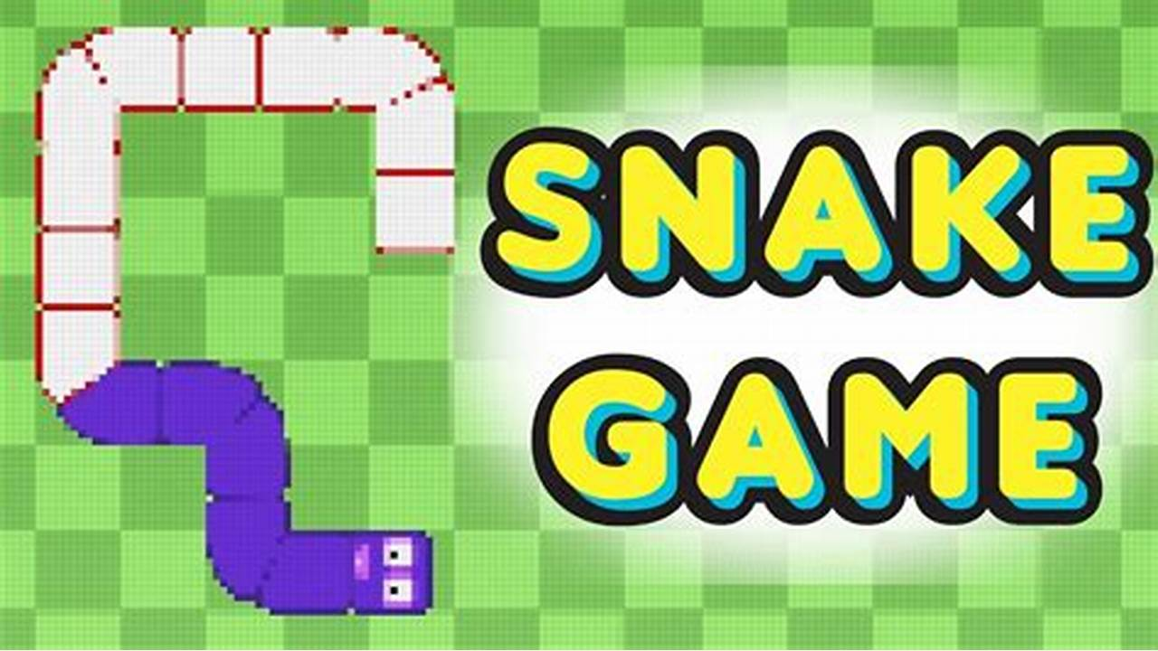
Presentation on:
Snake Game (ICT-1200) (A simple console based snake game)
Under the guidance of:
Associate Professor Dr.
Md. Abir Hossain sir.
Department of Information and Communication Technology.
Mawlana Bhashani Science and Technology University, Santosh,Tangail .
Presented by:
Name: Sahriar Ahmed Tarek & Annay Das.
ID: it-22047 & it-22048.

Slide 2
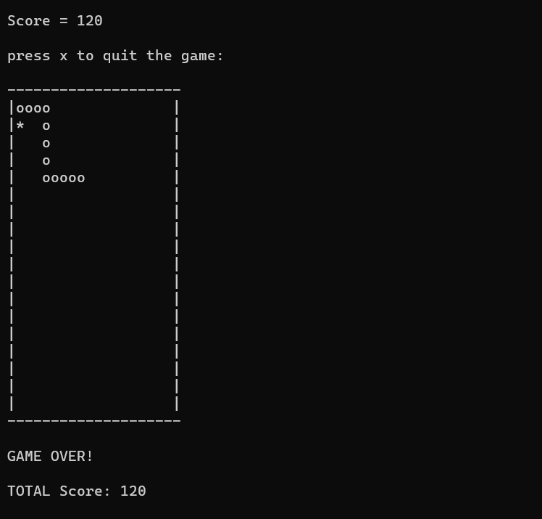
Introduction:
The game called “snake” or “snake game” typically involve the player controlling a line or snake, there is no official version of the game, so gameplay varies.
The most common version of the game involves the snake of line items which make it longer, with the objective being to avoid running into a border for as long as possible.
The player loses when the snake runs into a border. Because of this, the game becomes more difficult as it goes on, due to the grouth of the snake.

Slide 3
OBJECTIVES:
This project in c language of “snake game” is a simple console application. In this project, you can play the popular “snake game” just like you played it elsewhere. You have to use the W,A,S,Z character to move the snake.
Foods are provide at the several co-ordinates of the screen for the snake to eat. Every time the snake eats the food , its length will by increased by one unit along with the score.
It isn’t the world’s greatest game , but it does give you an idea of what you can achieve with a relatively simple C program, and perhaps the basis by which to extend the principles and create more interesting games of your own.

Slide 4
Features & about the project:
This snake game is just similar to games which are found under mobile games section.
An instruction has been given where users must go through the instruction to play the game.
Players will able to check their result after games get over.
The score section will display the total score of the player.
the number keys “W,A,S,Z” has been set within the program to move the snake to right, left, top and bottom respectively.
Random fruit generation: the fruit position has been set random, so whenever the head of snake touch the fruit new fruit will generate immediately at random location every time.
Tail grouth: Every time the snake eats the food, its length will by increased by one unit along with the score.
The highest score of the scorer will save in the file.

Slide 5
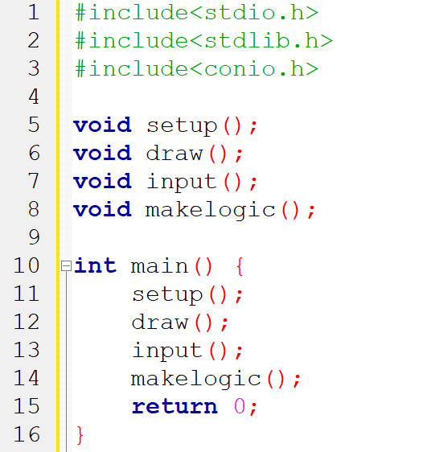
Project overview:
Bsaicaly this snake game project divides into four user defined functions which are:
Setup();
Draw();
Input();
Makelogic()
We call those functions from the main function.

Slide 6
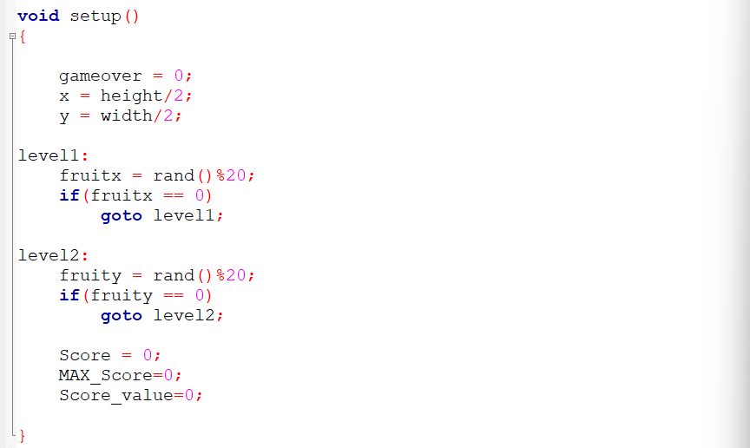
Void setup() function:
Code:

Slide 7
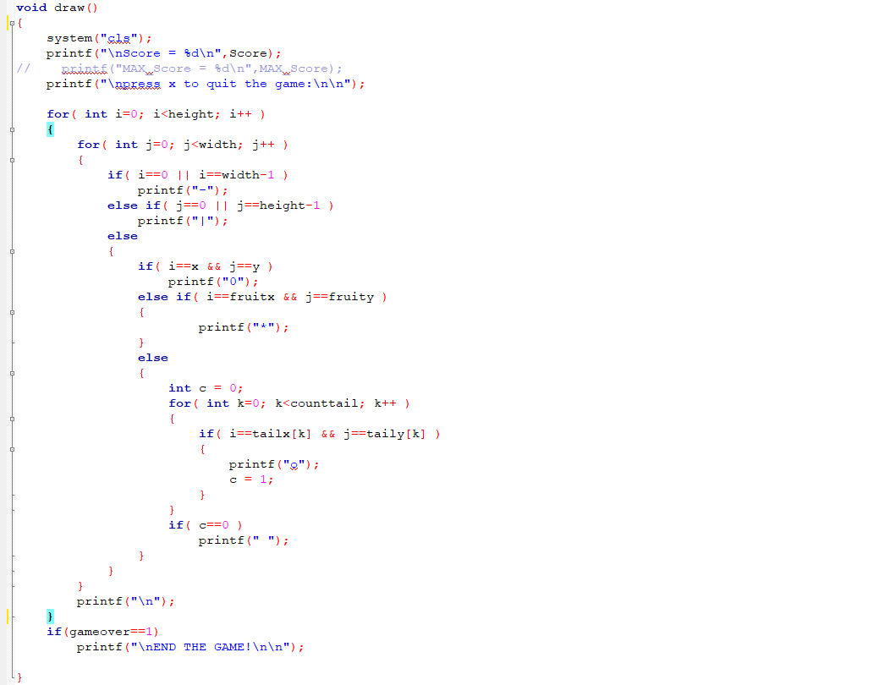
Void draw() function:
Code:

Slide 8
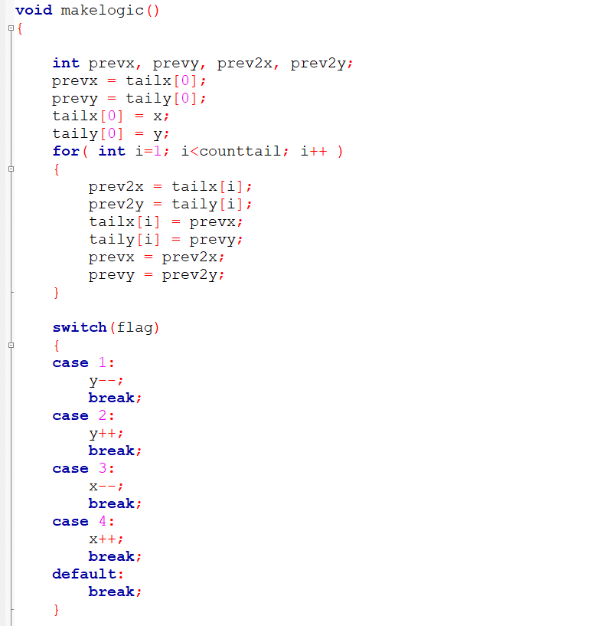
Void makelogic() function:
Code:

Slide 9
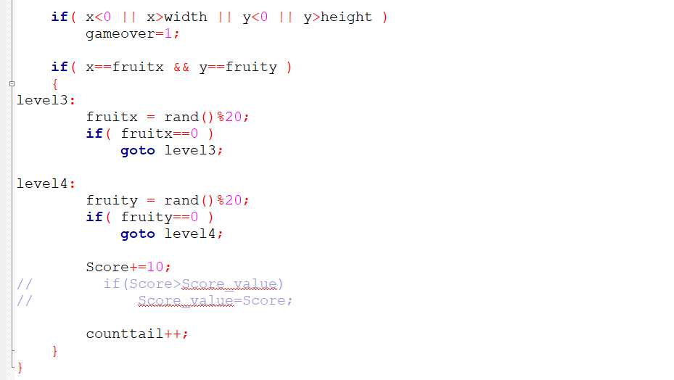
(con…)

Slide 10
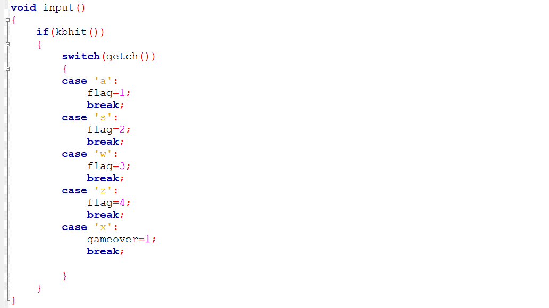
Void input() function:
Code:

Slide 11
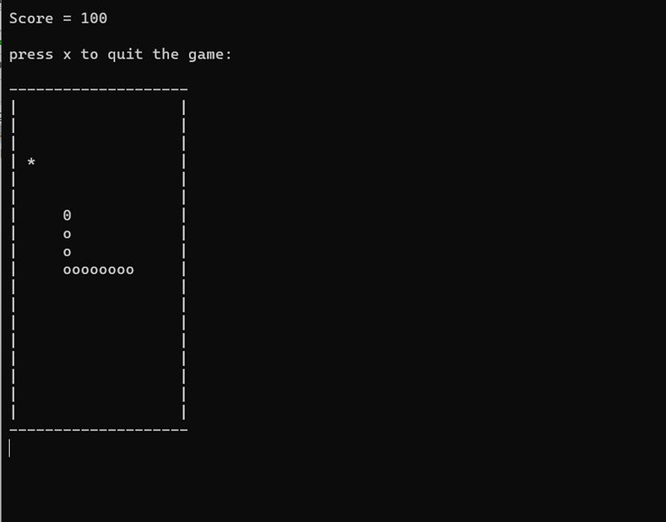
OUTPUT SCREEN:
Movement of the snake and fruit generating.

Slide 12
FUTURE SCOPE OF THE PROJECT:
Our project will be able to implement in future after making some changes and modifications as we make our project at a very low level. So the modifications that can be done in out project are:
It can be made with good graphics.
We can add more options like player profile.
We can add multiplayer option.
We can add mode option depends on the players stability that is “easy, medium, and hard” mode.

Slide 13
Thank you for your attention.
.

